Slide 1
Egbaidomeh Daniel Ehiz
Graphical Representation and Interpretation of Exploratory Data Analysis.
In Partial Fulfilment of BiWeekly Challenge 4.

Slide 2
The Statement of the problem is to train the dataset to predict the possibility of a patient's survival or death.
There are 299 rows which contains individual observations and 13 columns which shows segregations by age, gender, health conditions, and the target column - Death Event
The aim is to perform an Exploratory Data Analysis to show relationships between variables, and get detailed insights provided by the dataset

Slide 3
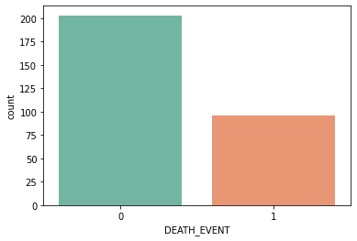
Generally, there are more survivors than dead patients. Approximately 7 out of every 10 patient survived, while 3 died.

Slide 4
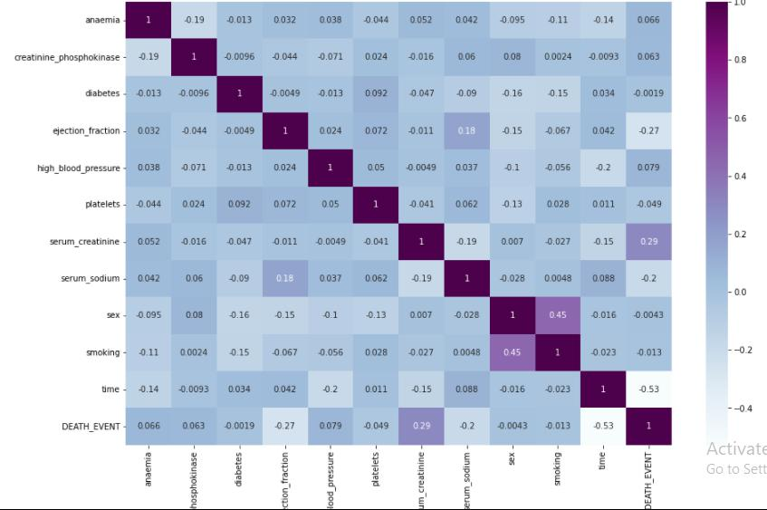
The correlation matrix shows there are no causalities between the independent variables and the dependent variable – Death Event

Slide 5
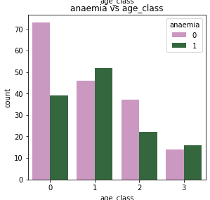
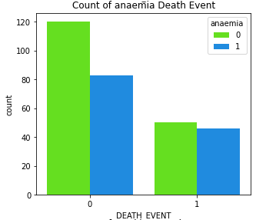
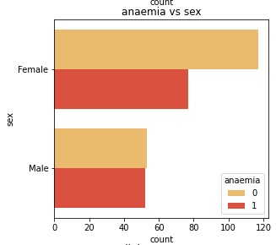
ANAEMIA VS AGE, SEX and MORTALITY RATE.
More patients within the age range of 55 – 65 years of age has anaemia.
Above 50% of patients has anaemia, and most are females
Visibly, 50% of all patients with anaemia didn’t survive it.
Almost all male, 98% precisely, has anaemia, while 70% of females has anaemia
There are lesser survivors of anaemia than any other listed ailment. More dead patients with anaemia than any other.

Slide 6
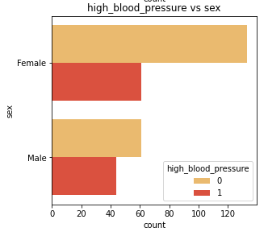
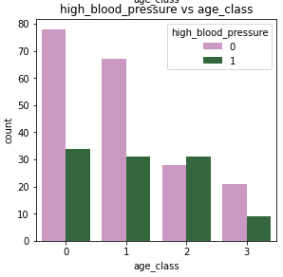
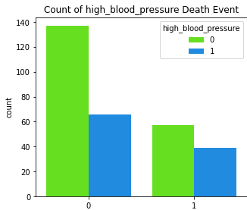
HIGH BP vs AGE, SEX, and MORTALITY RATE.
More females have High BP occurrence than males.
Old adults (65 -75 years) have higher occurrence of High BP
An average of 35% patients have High BP
About 70% of 35% patients with High BP didn’t survive.
About 80% of dead patients have high blood pressure

Slide 7
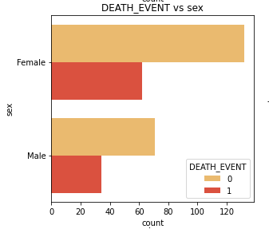
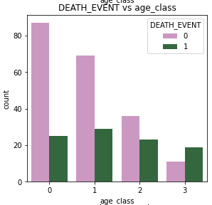
MORTALITY RATE vs AGE and SEX.
With respect to total number of observations, there are more death cases in female than male with an average of 65 female deaths, and average of 35 male deaths. While with respect to gender segregation, there is higher mortality rate in male than female, with an average of 45% female mortality rate and an average of 50% mortality rate in male.
Mortality rate is high within the age class of 55 - 65 years old. 85- 100 years has the least mortality.

Slide 8
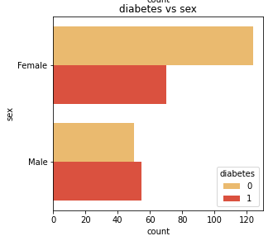
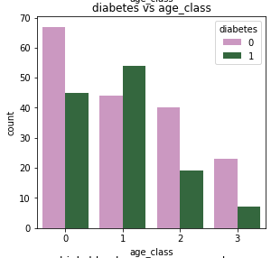
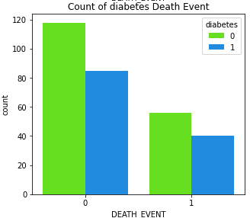
DIABETES vs SEX, AGE, and MORTALITY RATE.
An average of 6 out of 10 females are diabetic. While there are more males with diabetes than there are not.
Mid aged adults (55 – 65 years old) are more diabetic, while older adults has least occurrence. Its pertinent to deduce that younger adult below the age of 65 are more diabetic than older adults above the age of 65.
An average of 45% total observation of patients with diabetes didn’t survive.
About 80% of dead patients are diabetic

Slide 9
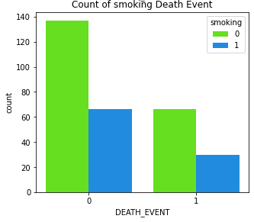
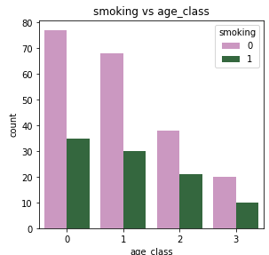
SMOKING vs MORTALITY RATE.
There are more female smokers than male smokers.
The youngest class of adults smokes hardest, while the consumption reduces the older they grow.
Smoking doesn’t variably affect mortality as it has the lowest mortality rate of all the independent variables

Slide 10
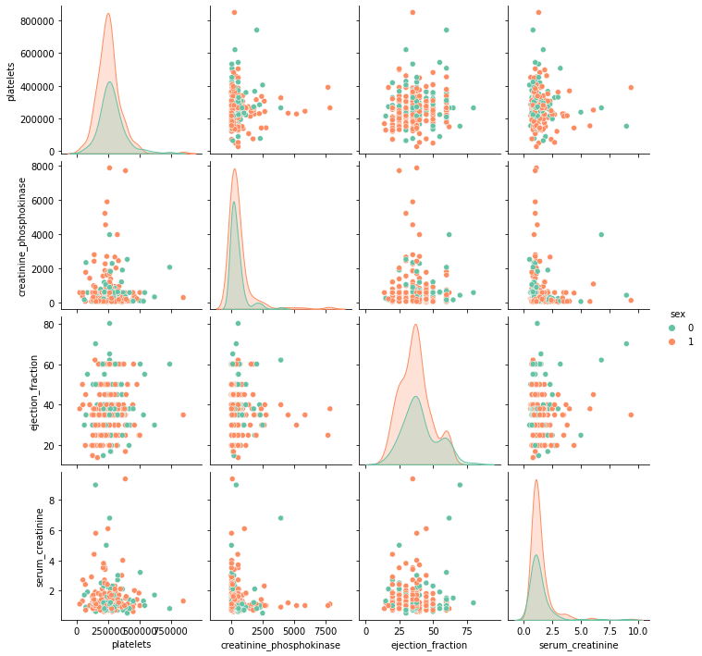
Pair Plot showing relationship between 5 feature engineered variables
These variables have the highest causality with Death

Slide 11
THANK YOU

